Slide 1

Two-photon direct laser writing of ultracompact multi-lens objectives
Timo Gissibl , Simon Thiele, Alois Herkommer and Harald Giessen
13/12/2022
Nanodispositivos e Nanoeletrónica
1

Slide 2
INDEX
1) INTRODUCTION
Motivation and Goal (slide 4).
Other Fabrications Methods (slide 5 and 6).
2) DESIGNS, FABRICATION AND METHODS USED
Optical Design Software: ZEMAX (slide 8 and 9).
Femtosecond Laser Lithography System (slide 10).
3) RESULTS, THEIR DISCUSSION AND CONCLUSIONS
13/12/2022

Slide 3
Introduction
1
13/12/2022
Nanodispositivos e Nanoeletrónica
Notes:
The objective of this work is the manufacture of micro-lenses. Why is this fabrication and its use important? Micro-optics technology is becoming increasingly important in the development of optical systems. For example, recent improvements to CMOS image sensors would allow for further miniaturization of them, but there are no lenses to go along with it. Hence, it is even necessary to manufacture these lenses differently, which allows them to be in the order of micro.

Slide 4
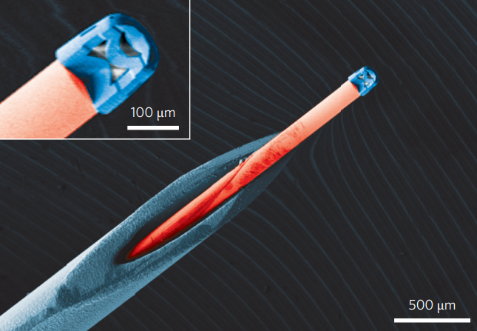
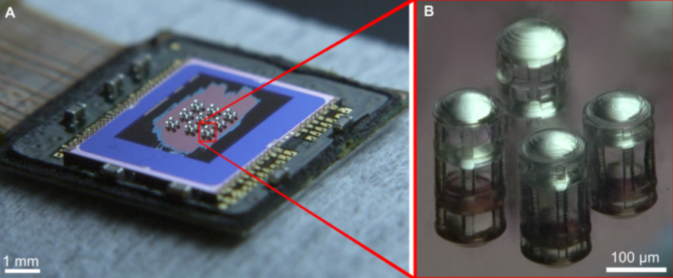
Motivation and Goal
Figure 2 – Regular arrangement of double lens systems directly fabricated on a CMOS image sensor.
Figure 1 - Coloured SEM image of a triplet lens objective attached to na optical fibre inserted into the hollow needle of a syringe.
13/12/2022
Notes:
These devices are currently in great use since they are a wide application, not only in image sensors, but also in various systems, such as:
Οπτιχαλ ιντερχοννεχτσ
Πηοτοδετεχτορσ
Οπτοελετρονιχ χομπονεντεσ ιν ινεγρατεδ χιρχυιτσ χηιπσ
Μινιατυρε δρονεσ ανδ ροβοτσ ωιτη αυτονομουσ ϖισιον
Νεω ιλλυμινατιον σψστεμσ
Βιο−μεδιχαλ αππλιχατιονσ
Ανδ σο μυχη μορε
With this article, it was possible to create micro lenses with good performance and fast manufacturing, but this will be explored later. But I will already leave an example of the applications of the devices obtained from the experience of this work: in endoscopies, as we see in the image, they will allow a non-invasive examination of the patient and thus obtain images of the interior of an organ or of another cavity within the same body. Another example, as I said, will be its application in CMOS image sensors, as we see in figure 2.

Slide 5
Other Fabrications Methods
Monolithic production
Injection molding
Ink-jet printing
Ultraviolet lithography
…..
PROBLEMS:
Limits on size, shape and dimensions
Inability to combine multiple elements
Restrictions in designing the surfaces
Problems with the alignment
13/12/2022
Notes:
On this slide, what we have are other manufacturing methods that already exist. Bear in mind that these are just a few examples and have nothing to do with my article, they were just placed to understand that effectively the authors' objective was to create a manufacturing method that did not have the same problems that these present.
So far, multi-lens optics, which have what we can consider good performances, but have several problems such as: -> reading problems
There is a limitation of size, structure and dimensions associated with these methods;
Inability to combine multiple elements
Restrictions in designing the surfaces
Problems with the alignment
As well as the complexity and investment required to make them

Slide 6
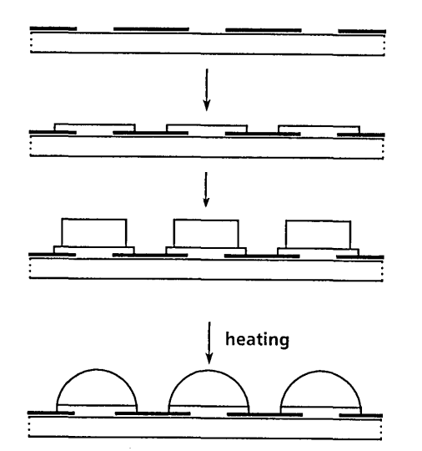
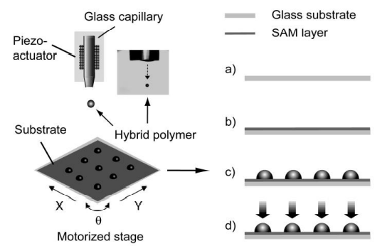
Other Fabrications Methods
Figure 4 – Schematic diagram of the DOD ink-jet printing and the process flow used to fabricate
microlenses.
Figure 3 – Process steps for production of microlenses using de monolithic fabrication method.
13/12/2022
Notes:
These are schematics of two manufacturing methods given on the previous slide.

Slide 7
Designs, Fabrication and Methods used
2
09/11/2022
Nanodispositivos e Nanoeletrónica

Slide 8
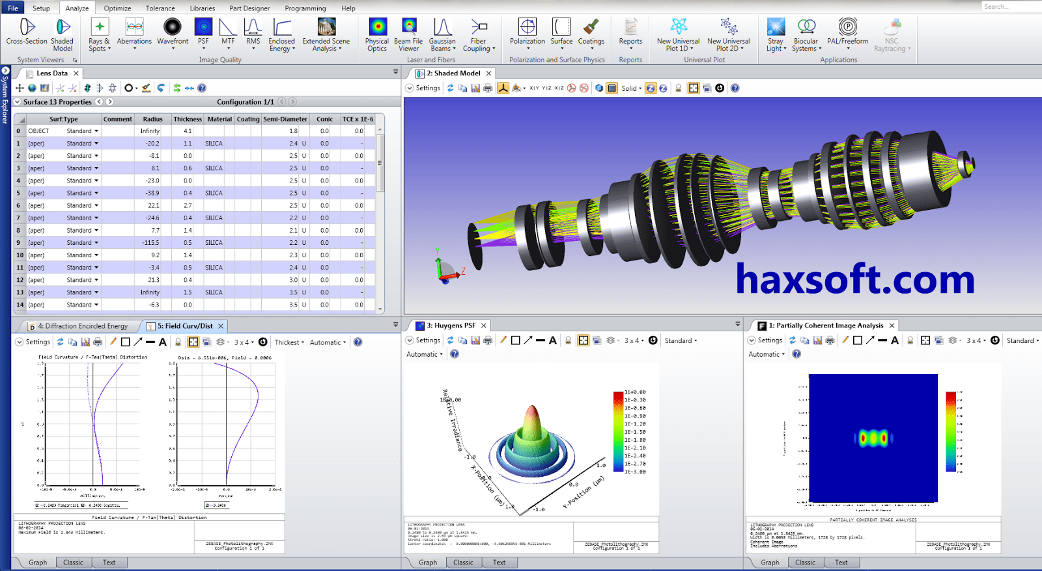
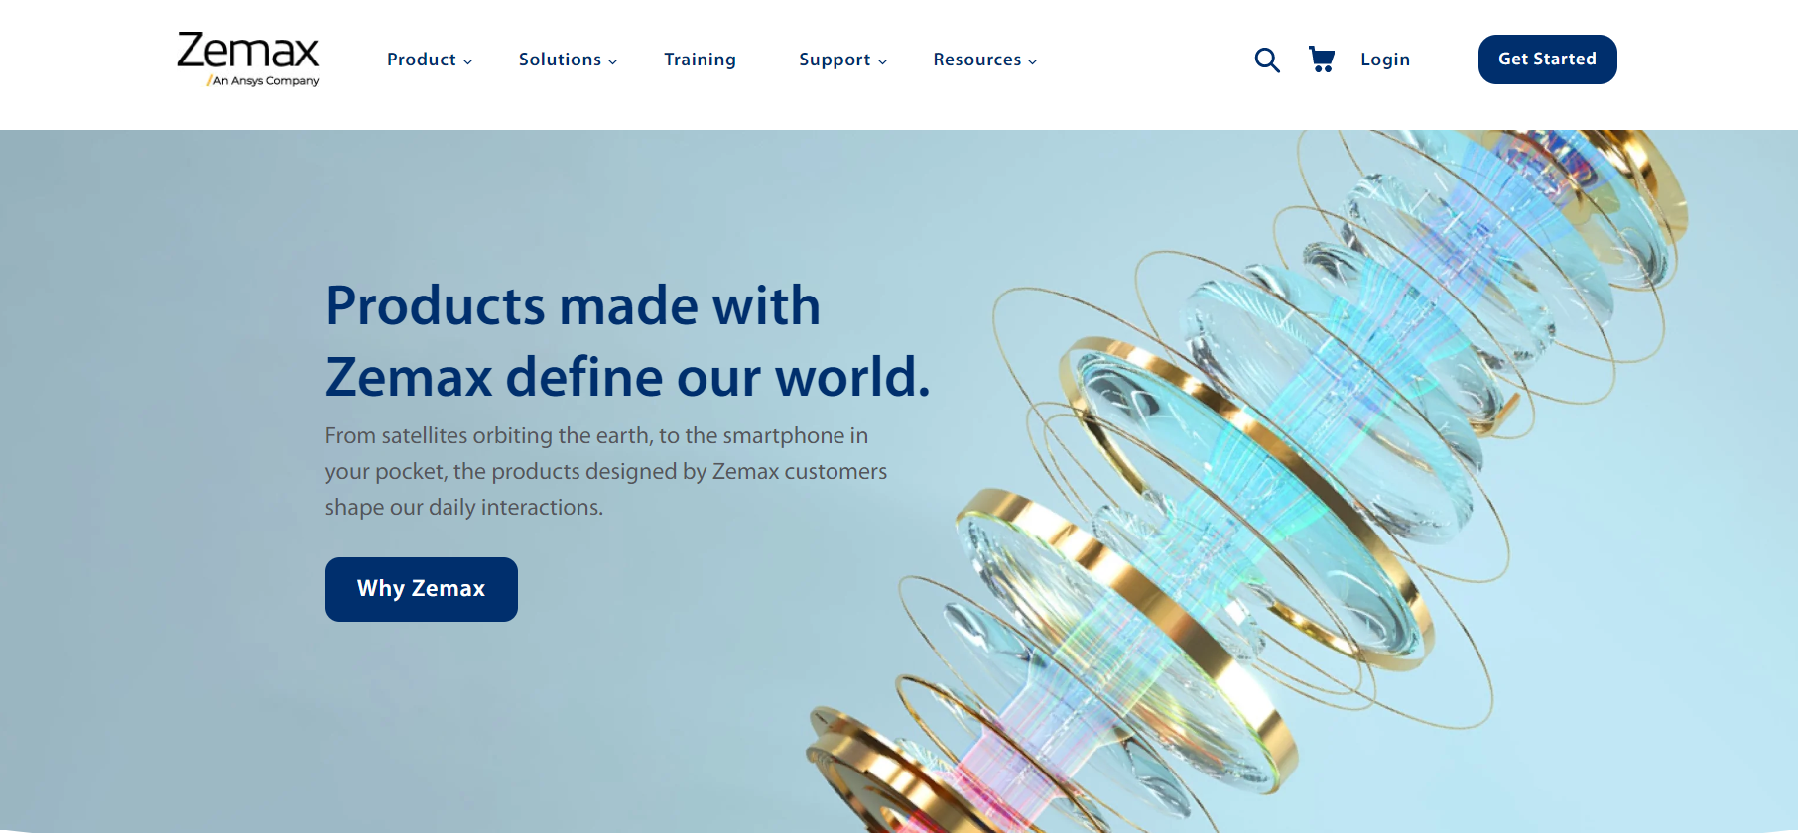
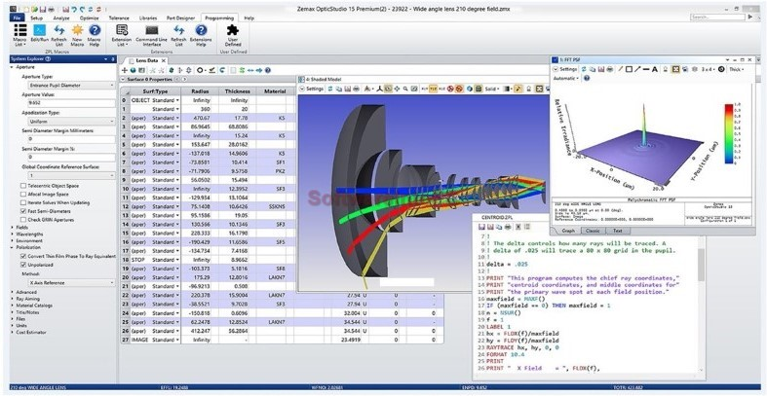
Optical design software: ZEMAX
Link: https://www.zemax.com/
13/12/2022
Figures 5 and 6 - Examples of what we can do with ZEMAX
Notes:
In fact, contrary to what is written in the article, Zemax is not the software, but the company that created it. But this software is normally used for the design and analysis of both imaging and illumination systems. It works by ray-tracing – modeling the propagation of rays through in an optical system.
The submicrometric compound lenses presented in this article are designed and optimized within this software.

Slide 9
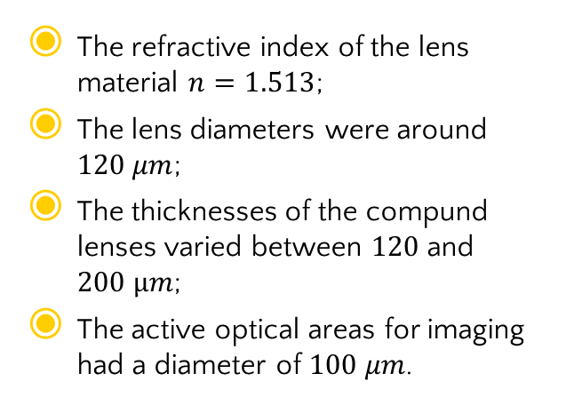
Optical design software: ZEMAX
The refractive index of the lens material $n=1.513$;
The lens diameters were around $120 μm$;
The thicknesses of the compund lenses varied between $120$ and $200 μm$;
The active optical areas for imaging had a diameter of $100 μm$.
Computer – Aided Design file format
Stereolithographic file format
13/12/2022
Notes:
It is also important to say, and it is not written here, is that the even aspheric surface parameterization was used as the surface type of the refractive interfaces. This is important because aspheric surfaces are normally used to compensate for optical aberrations and improve the image quality for each surface, but we will talk about this later.
After the simulations were done, the designs were exported into a computer-aided design file format and then transformed into a stereolithographic file format, to be able to carry out the next part.

Slide 10
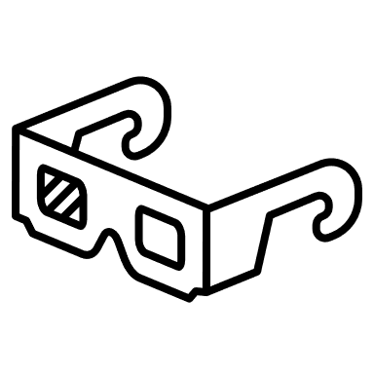
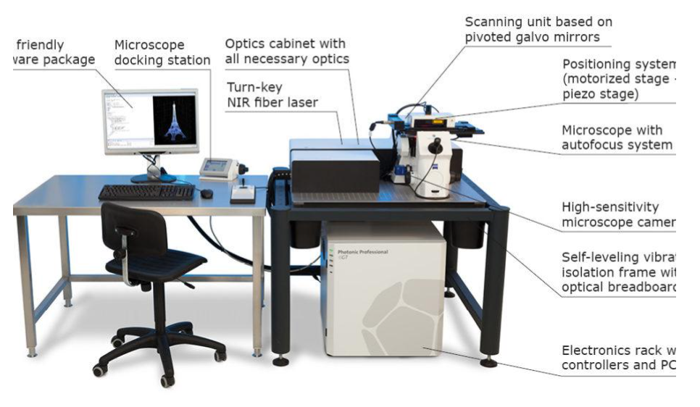
Femtosecond Laser Lithography System
Figure 7 – Example of a Nanoscribe Photonic Professional GT 3D Printer
13/12/2022
Notes:
And so, what was used to manufacture these multi-lens objectives? Well, the compound lenses were fabricated by 3D dip-in direct laser writing using a commercially available femtosecond laser lithography system (which is included in the system in figure 7).
The complete optical compound system is manufactured from one single material. They therefore used a photoresist that exhibits high optical quality.
The numerous compound lenses were exposed by two-photon absorption (or 2PP) in an ultraviolet sensitive photoresist at a wavelength of 780 nm. The designed structures were written layer-by-layer with 100 nm between the individual layers. For this, ultraprecise piezo actuators would move the sample in the axial direction after fabricating each layer. In the lateral direction the laser beam is guided by galvanometric mirrors parallel to the substrate. After the writing process, the lenses were developed in a bath of developer for 20 min and a subsequent rinsing bath of isopropanol for 2 min (this bath has the objective to remove the non-photopolymerized material).
The fabrication method allows for optical elements with 3D structures with resolution beyond the diffraction limit, unlike the other manufacturing methods shown previously, which only propose a maximum resolution of only a few micrometers.

Slide 11
Results, their Discussion and Conclusions
3
13/12/2022
Nanodispositivos e Nanoeletrónica

Slide 12
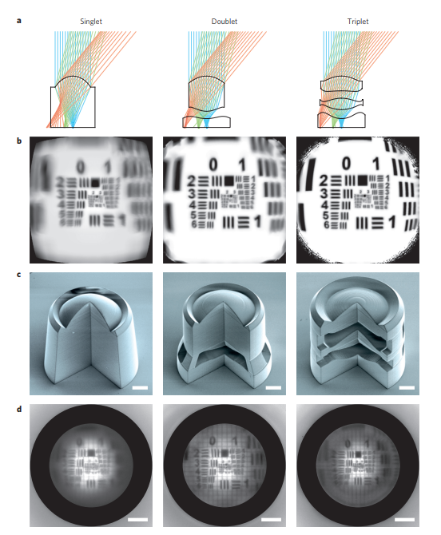
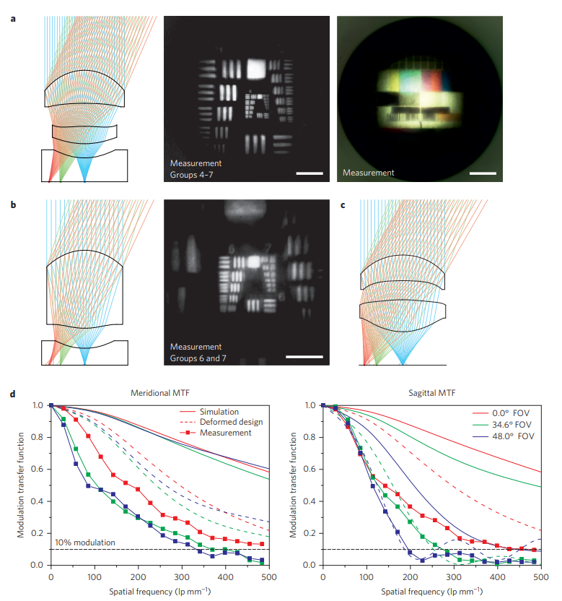
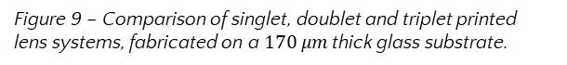
Figure 9 – Comparison of singlet, doublet and triplet printed lens systems, fabricated on a $170 μm$thick glass substrate.
Figure 10 – Performance measurement using the USAF 1951 resolution test chart, the Telefunken FuBK test card and the knife-edge methodology to
determine the MTF.

Slide 13
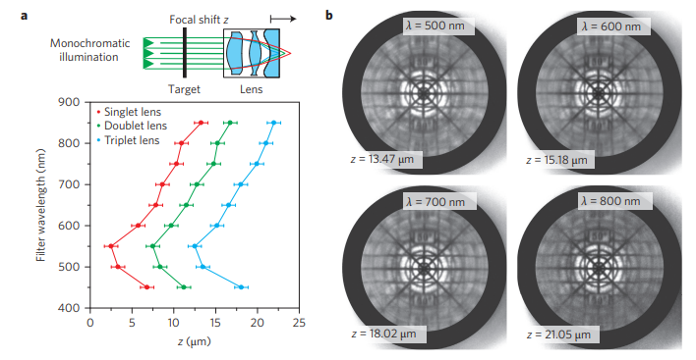
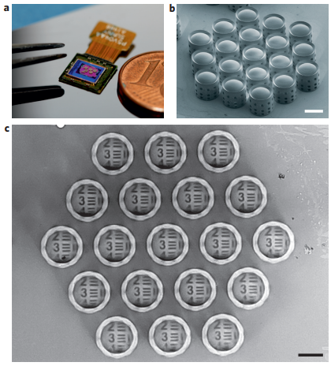
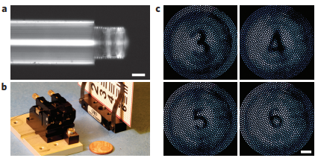
Figure 11 – Measurement of the longitudinal (axial) chromatic aberration.
Figure 12 – Regular arrangement of doublet lens systems directly fabricated on a CMOS image sensor.
Figure 13 – Triplet objective lens system fabricated directly on an imaging fibre.
Notes:
Modulation Transfer Function or "MTF" is a measurement of the optical performance potential of a lens. MTF charts can give you a better understanding of the optical quality of various NIKKOR lenses, and can be useful references when researching, comparing and purchasing a lens.

Slide 14
What was shown in this article was basically the interface between micro and nano optics and as represented the paradigm shift for micro-optics.

Slide 15
Thanks!
Any questions ?
Beatriz Sousa Demétrio
PG50256
pg50256@alunos.uminho.pt
Mestrado em Engenharia Física
13/12/2022
Nanodispositivos e Nanoeletrónica

